Slide 1
Digital Business Capability
Agile Workshop
11-May-23

Slide 2
Traditional Lifecycle Methods - Challenges
Business/
Products
Tech
Operations
No working software is produced until late during the life cycle (delayed ROI)
Poor model for long and ongoing projects
Not suitable for the projects where requirements are at a moderate to high risk of changing
Cannot accommodate changing requirements
Integration is done as a "big-bang. at the very end, which doesn't allow identifying any technological or business bottleneck or challenges early
Communication happened through documentation

Slide 3
Agile Manifesto
“We are uncovering better ways of developing software by doing it and helping others do it. Through this work we have come to value:”
Individuals and interactions over processes and tools Working software over comprehensive documentation Customer collaboration over contract negotiation Responding to change over following a plan
That is, while there is value in the items on the right, we value the items on the left more.

Slide 4
12 Agile Principles (Simplified)
Customer Satisfaction – Highest Priority
Deliver Frequently
Welcome Changing Requirements
One Team
Motivated
Individuals
Working Software
Face-to-face
Conversation
Sustainable
Development
Maintain Technical Excellence
Emerging Architecture & Design
Simplicity
Reflect & Improve

Slide 5
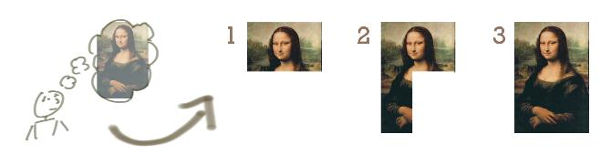
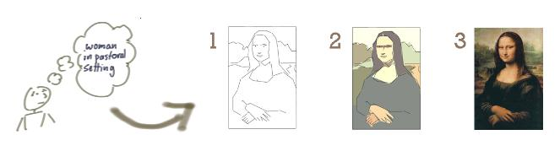
Basics & Terminologies
Incremental & Iterative Development
What is Incremental Development
Incrementing calls for a fully formed idea “incrementing” builds a bit at a time.
More like a “Waterfall” approach
What is Iterative Development
Allows to move from “vague” idea to realization .
Builds a rough version, validates it, then builds quality up

Slide 6
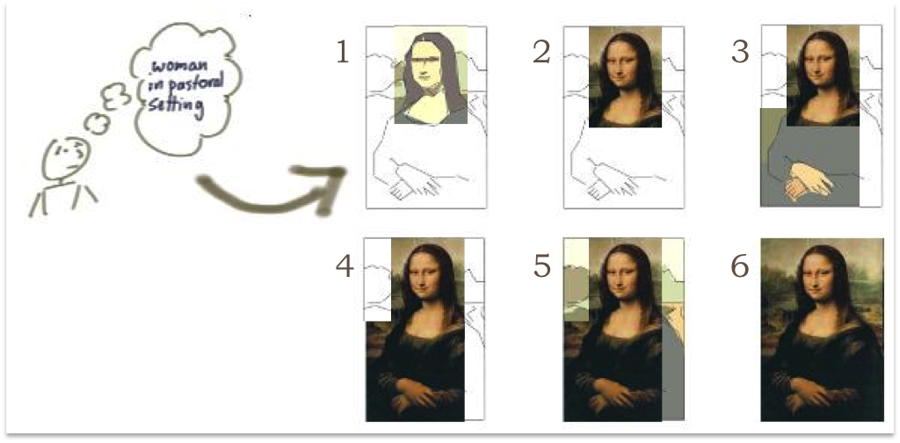
Basics & Terminologies
Incremental & Iterative Development
What is Incremental & Iterative Development
Incremental:
Increment adds completely new features, based on user stories
Hence expands the scope of the functionality offered – that makes it incremental
Iterative:
Each sprint / release also refines existing functionality – thereby making it iterative

Slide 7
What Agile Is NOT
Just about writing code
(But is really about how people work together)
Undisciplined
(Agile needs a lot of discipline to deliver quickly & consistently)
Unstructured
(Rules in Agile are quite strict. Follows specific methodology / framework)
Not a Silver Bullet
(Agile does not guarantee success of project, unless followed appropriately)
Not Anti-Documentation
(Agile does not prefer documentation just for the sake of creating it)

Slide 8

SCRUM

Slide 9
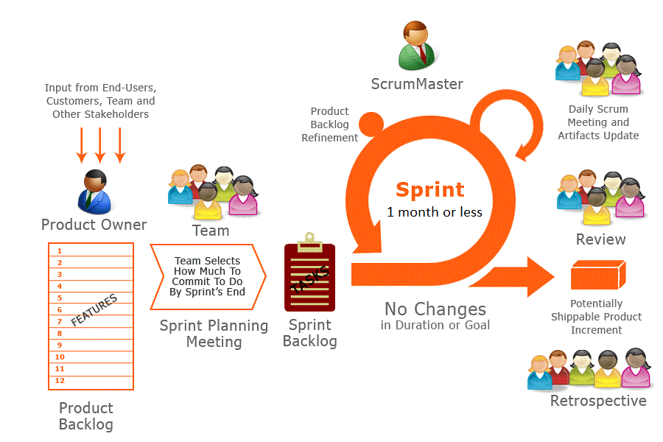
SCRUM
3 Accountabilities
3 Artifacts
5 Ceremonies
5 Values

Slide 10
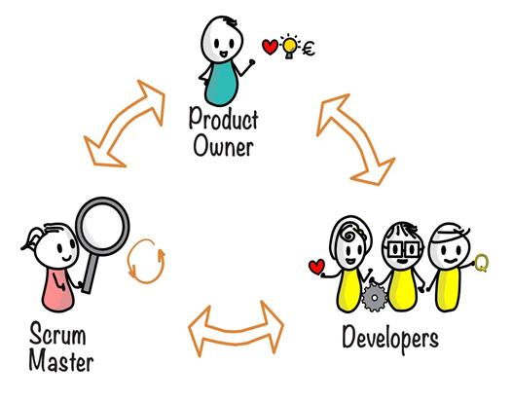
Scrum Team
Who?
Scrum Team - Fundamental unit of Scrum
Consists of 1 Product Owner, 1 Scrum Master and Developers
No sub-teams or hierarchies
Cohesive unit of professionals focused on one objective, the product goal
Small team with 10 or less people
Empowered by organization to manage their own work
Responsible for?
For all product related activities – stakeholder collaboration, verification, maintenance, operation, experimentation, research & development
Accountable for?
Creating a valuable, useful Increment every Sprint
*Note: If a Scrum team becomes too large, consider reorganizing into multiple cohesive scrum teams each focusing on same product – hence they share same Product Goal, Product Backlog and Product Owner

Slide 11

3 Accountabilities

Slide 12

Product Owner
Who?
One person playing the role and not a committee
Customer advocate
Sets product vision, direction
Accountable for maximising the value of product
Responsible to work with team to get user stories ready for next sprint
Prioritizes backlog based on business value
Has final say in any priority quibbles
Final decision maker on Product Backlog
Accepts / rejects work result
Accountable for – Effective Backlog Management
Developing and explicitly communicating product goal
Creating and clearly communicating product backlog items
Ordering (Prioritizing) backlog items
Ensuring that the product backlog items is transparent, visible and understood

Slide 13

Scrum Master
Who?
Serves the scrum team in several ways like
Coaching team members in self management & cross-functionality
Helping scrum team to focus on creating high value increments
Removal of impediments
Ensuring that all scrum events take place and are positive, productive and within the timebox
Serves the Product Owner in several ways like
Helping find techniques for effective product goal definition & product backlog management
Facilitating stakeholder collaboration as requested or needed
Helping the scrum team to understand the need for clear and concise product backlog items
Serves Organization in several ways like
Leading, training & coaching Scrum
Helping employees and stakeholder understand an empirical approach for complex work
Accountable
Establishing Scrum as defined in Scrum Guide
Creating and clearly communicating product backlog items
For Scrum team’s effectiveness

Slide 14

Developers
Who?
Committed to creating any aspect of a usable Increment each Sprint
Cross functional - BA, developer, UX designer, tester etc.
T-Shaped people
Self-managed team: No management title, takes most of the project management work
Learning mindset as opposed to fixed mindset
Collectively responsible for reaching sprint goal
Manages sprint backlog & tracks progress
Makes continuous self-improvements
Accountable
Creating a plan for the sprint, the Sprint Backlog
Instilling quality by adhering to Definition of Done
Adapting their plan each day towards the Sprint Goal
Holding each other accountable as accountable

Slide 15
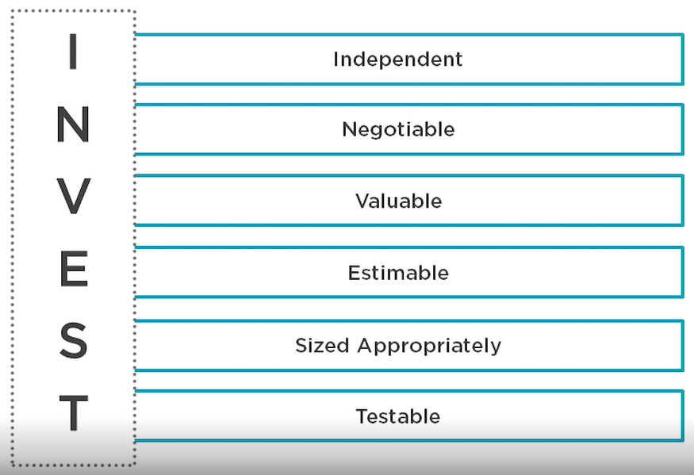
User Story
Is not part of Scrum framework, Idea is taken from “Extreme Programming” due to its simplicity & effectiveness
Helps shift the focus from writing about requirements to talking about them
Includes a written sentence or 2, and more importantly, a series of conversations about the desired functionality
Are short, simple descriptions of a feature told from the perspective of the person who desires the new capability, usually a user or customer of product
User Story Format
Has 3 parts
Who: Describe the intended user
What: Describe what they need & want
Why: Purpose of their ask
Format: As a <user>, I want <what> so that <why>
Often written on sticky notes, index cards and arranged on walls / boards
Strongly shifts the focus from writing about features to discussing about them
Sample:
As a Credit Card Holder of ABC Bank, I want to view my statement balance so that I can pay the balance due

Slide 16
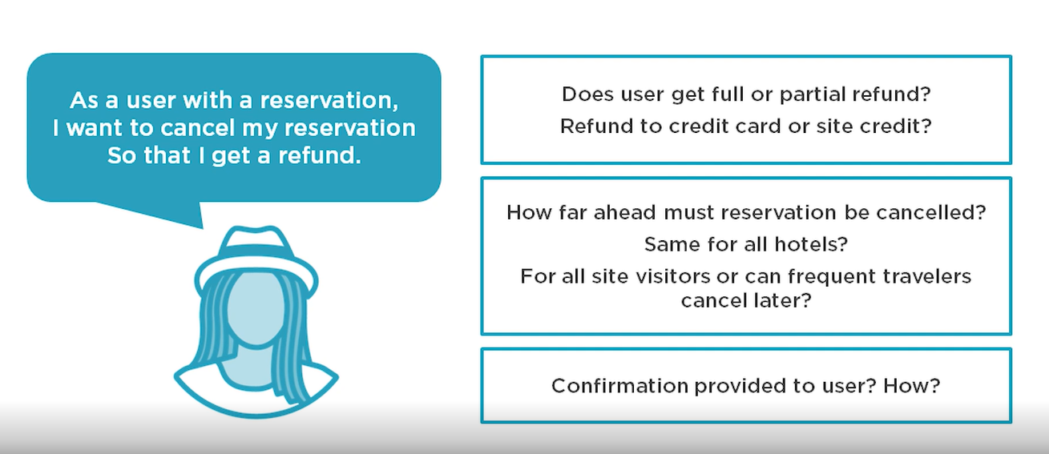
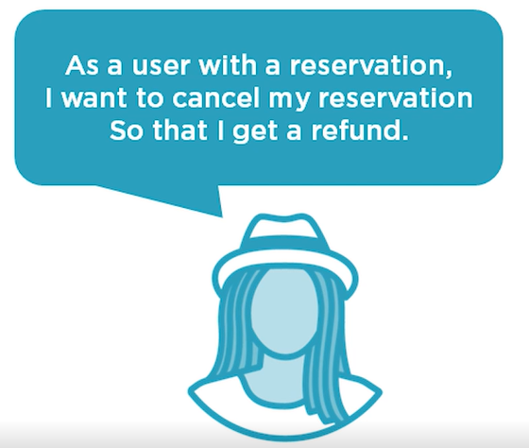
User Story – Additional Details

Slide 17
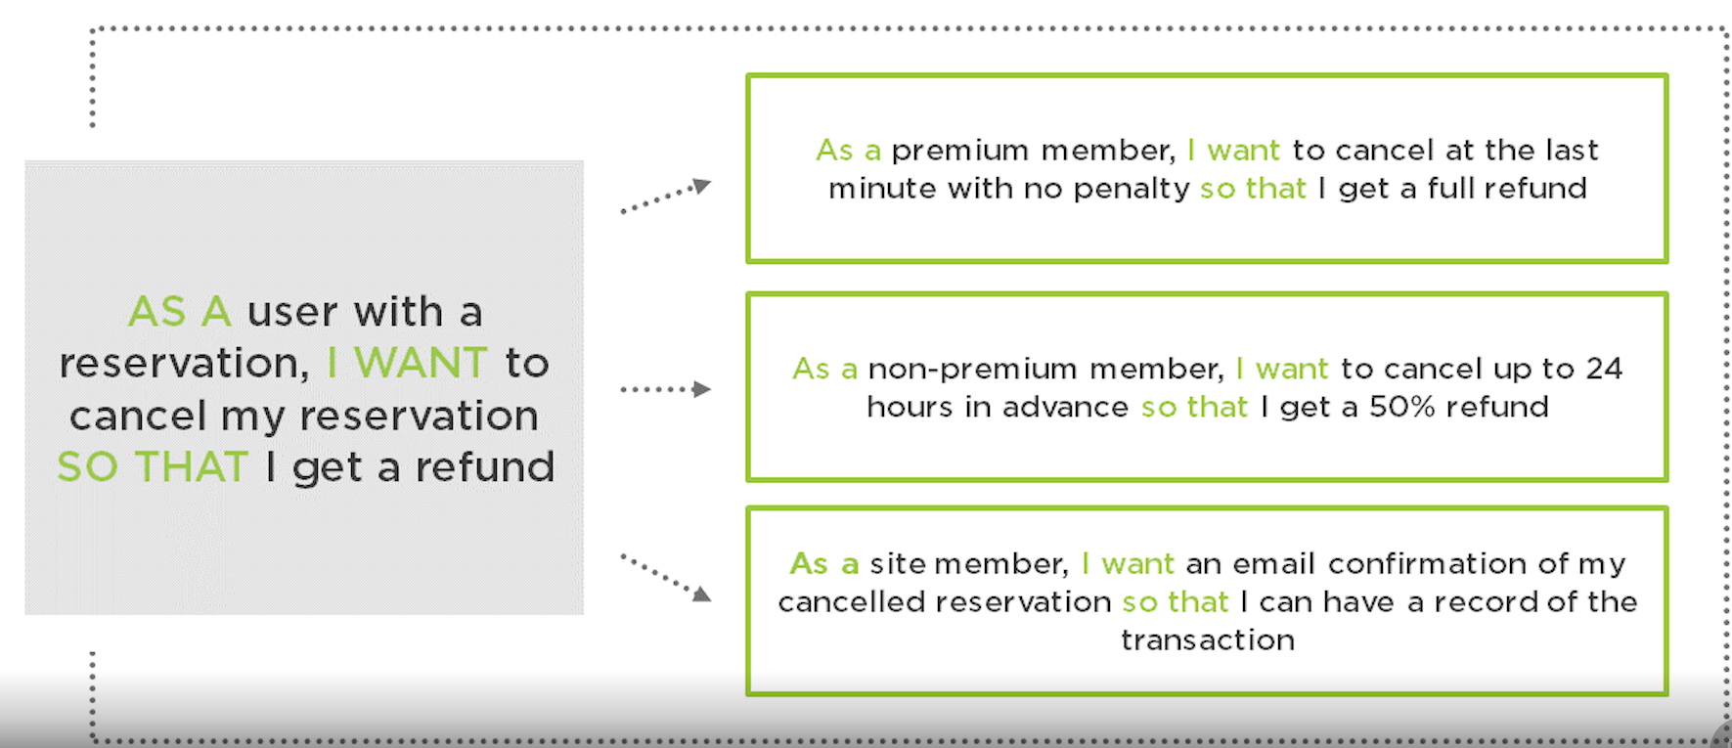
User Story – Details as smaller sub-stories

Slide 18
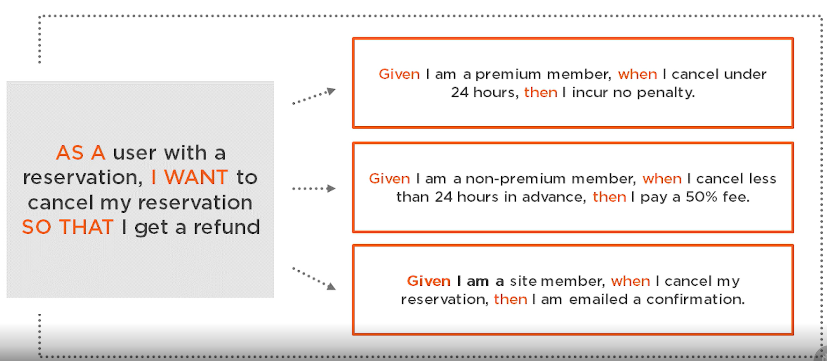
User Story – Acceptance Criteria: Given / When / Then

Slide 19
3 Artifacts

Slide 20
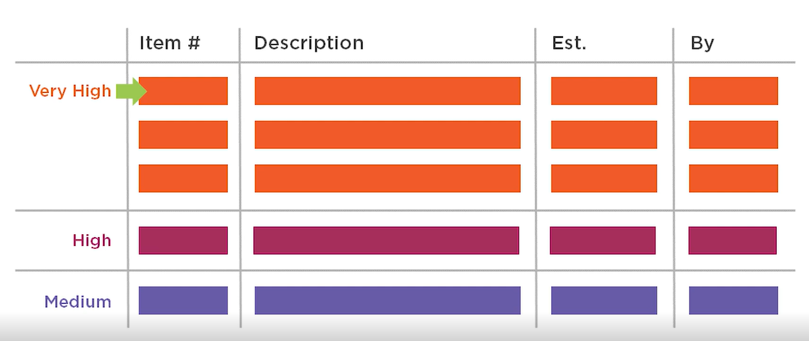
Product Backlog
Product Backlog
Product Goal is the commitment for Product Backlog
Is an emergent, ordered list of "requirements" that is maintained for a product
Single source of work taken by Scrum team
Top priority items on top (priority descending)
Enough work for 2-3 iterations must be groomed
PO’s responsibility
Prioritized by PO
Has items that May or may not get done
Has rough estimates of both business value and development effort
Product Goal
Describes a future state of the product which can serve as a target for Scrum team to plan against
Product goal is the product backlog
Long term objective for the scrum team

Slide 21
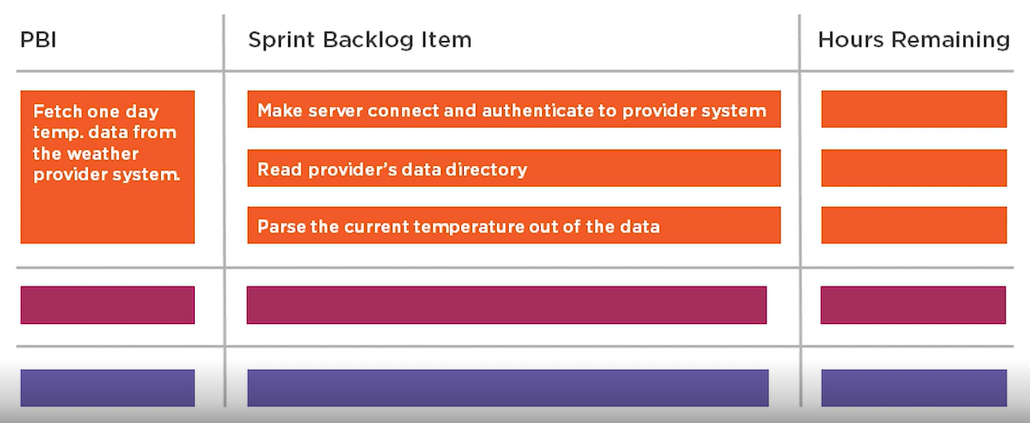
Sprint Backlog
Sprint Backlog
Sprint Goal is the commitment for Product Backlog
Composed of Sprint Goal (why), set of Product backlog items selected for the sprint (What) as well as an actionable plan for delivering the increment (How)
Is a Plan by and for the developers
Highly visible, real-time picture of the work that developers plan to accomplish during sprint
Updated throughout the sprint as more is learned
Sprint Goal
Single objective for the Sprint
Creates coherence and focus, encouraging scrum team to work together
Created during sprint planning event
If the work turns out to be different, the developers will collaborate with PO to negotiate the scope of sprint backlog without impacting the sprint goal

Slide 22
Working Software / Increment
Increment
The ”increment” is sum of all Product Backlog Items completed during a sprint and all previous sprints.
At end of a sprint, Increment must be done according to Scrum Team's definition of done.
The increment must be in usable condition regardless of whether the Product Owner decides to release it
Definition of Done (DoD)
Formal description of the state of the increment when it meets the quality measures required for the product
If DoD is part of the organization’s standards, all scrum teams must follow it as a minimum
If DoD is not part of organization’s standard, the scrum team must create DoD that is appropriate for the product

Slide 23
5 Ceremonies

Slide 24
Sprint
What?
Sprints are heart-beat of Scrum
Fixed length events of 1 month or less
New Sprint starts immediately after the conclusion of previous sprint
All the work necessary to achieve the Product goal – including all events – happen within the sprint
During Sprint
No changes are made that would endanger the Sprint goal
Quality does not decrease
Product backlog may get refined, if needed
Scope may be clarified and renegotiated with the product owner as more is learned
Sprint Cancellation
A Sprint can be cancelled only if the Sprint Goal becomes obsolete
Only Product Owner has the authority to cancel the Sprint

Slide 25

Sprint Planning
Goal:
Define Sprint goal, achievable outcome
How:
Part1: Why is the Sprint valuable?
PO Proposes how the product could increase the value
Achieve common understanding
Sprint Goal must be finalized prior to the end of Sprint Planning
Part2: What can be done in the Sprint?
Select items that can be accomplished in sprint
Part3: How will the chosen work get done?
Plan the work necessary to create an increment
Decompose product backlog items into smaller work items of 1 day or less
Who:
Scrum team
Time Spent:
8 hours for 4 weeks sprint
Roles:
Scrum Master: Facilitate discussion, Ensure PO is prepared
Product Owner:
Presents “What to do” / “Goal” using product backlog items
Provide clarity for each backlog item & acceptance criteria
Development Team:
Pull items from product backlog & plan for “how” to implement it
Discuss high level design approach, test area & other implementation areas
Create Sprint backlog – Sprint Goal, Product backlog items selected, plan for delivering
Sprint Goal must be finalized before end of Sprint planning

Slide 26
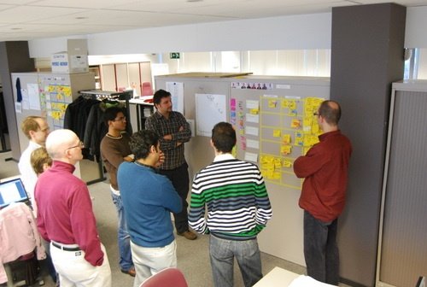
Daily Scrum (Standup Meeting)
Goal:
Plan for the day, Inspect & adapt daily towards reaching the sprint goal
How:
Can follow any mechanism as long as they focus on progress towards Sprint goal and product actionable plan for next day.
Helps in creating focus and improves self-management
Who:
Development team
Time Spent:
Max 15 minutes, daily
Roles:
Scrum Master:
Facilitates meeting
Timekeeper
Reflects & Notes impediments to work on
Product Owner:
An “Observer”
Understands if any clarifications are required for the team
Development Team: One of the popular mode is to Answers the following questions
What did I do since last daily scrum
What am I planning to work on today?
Are there any impediments blocking my work?
Daily Scrum promotes communication & quick decision making and eliminates the need of other meetings

Slide 27

Sprint Review (Show N Tell)
Goal:
Second last event of the Sprint
Inspect outcome of Sprint and determine future adaptations
How:
Scrum team presents the results of their work to key stakeholders and progress toward sprint goal is discussed
Based on information, attendees collaborate on what to do next
Product backlog may be adjusted to meet new opportunities
Who:
Scrum team + others (optional)
Time Spent:
4 hours for 4 weeks sprint
Roles:
Scrum Master: Facilitates & creates environment
Product Owner:
Provide Acceptance of working product
Updates release burn down
Forecasts new changes to the release
Development Team:
Demonstrate the working product
Focus on quality & definition of done
Sprint Review is a working session and Scrum Team should avoid limiting it to only a presentation

Slide 28
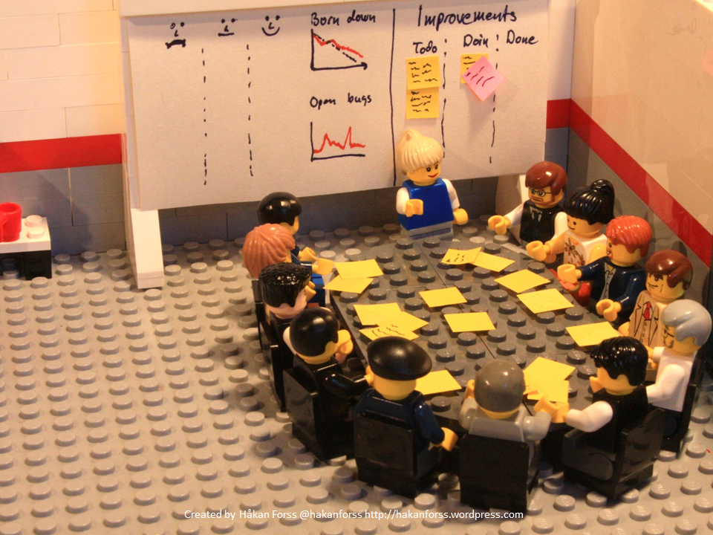
Sprint Retrospective
Goal:
To Plan ways to improve quality and effectiveness
To inspect & adapt to become more effective and efficient on process, people, cultural aspects
How:
Scrum team discussed what went well, what did not go well and how those problems were or were not solved
Scrum team identifies the most helpful changes to improve its effectiveness. The most impactful improvements are addressed as soon as possible and may get added to Sprint backlog of next Sprint
Who:
Scrum team
Time Spent:
3 hours for 4 weeks sprint
Roles:
Scrum Master: Facilitates & creates environment for transparency & effectiveness
Product Owner:
Participates to inspect & adapt as scrum team
Development Team: Answers the following
What went well in the sprint?
What did not go well in the sprint?
What changes do I wish to see in next sprint?
Sprint retrospective concludes the Sprint

Slide 29
Backlog Refinement
Refinement is not part of official Scrum Guide, however, is a best practice
Goal:
Keep product backlog items ready, move from uncertainty to certainty
How:
Adding, removing stories
Sizing, Breaking down stories
Reprioritizing stories
Adding info to stories
Who:
Scrum team
Time Spent:
10 % of sprint time
Roles:
Scrum Master: Facilitate discussion
Product Owner:
Provide clarity for each backlog item
Update product backlog
Development Team:
Listen to the need of product owner, Understand Acceptance criteria
Seek clarification, Help PO to order the backlog

Slide 30
5 Values

Slide 31





Scrum Values
FOCUS: Everyone focuses on the work of the Sprint and the goals of scrum team
OPENNESS: Open about all the work of the sprint and challenges with performing the work
RESPECT: Respect each other to be capable & independent
COURAGE: Courage to do right things and work on tough problems
COMMITMENT: Commit to achieve scrum goals

Slide 32

Characteristics of Scrum: Summary
All metrics, reports & deadlines are prominently displayed
No specific engineering practices prescribed
Activities are time boxed
Cross-functional & self-organizing teams
Product progresses in a series of sprints
Requirements captured as Items in Product Backlog
Continuously test product as it is created

Slide 33
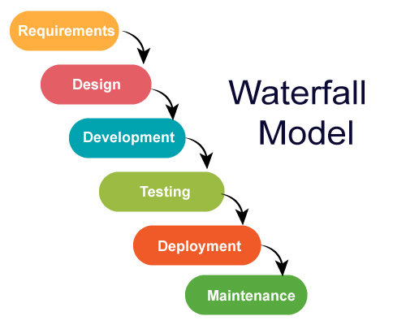
Traditional Lifecycle Methods
Advantages
Simple and easy to understand and use
Easy to manage due to the rigidity of the model. Each phase has specific deliverables and a review process
Phases are processed and completed one at a time
Works well for smaller projects where requirements are very well understood
Well understood milestones

Slide 34
What Agile Is
Iterative
(Make progress where the final goals are in a series of small deliverables)
Incremental
(Fully functioning modules are built up over time)
Adaptive
(Learn from performance & change course of action)
Value Based
(Highest value to customers is delivered first)
Easy to Understand
(Simple & Based on human nature)

Slide 35
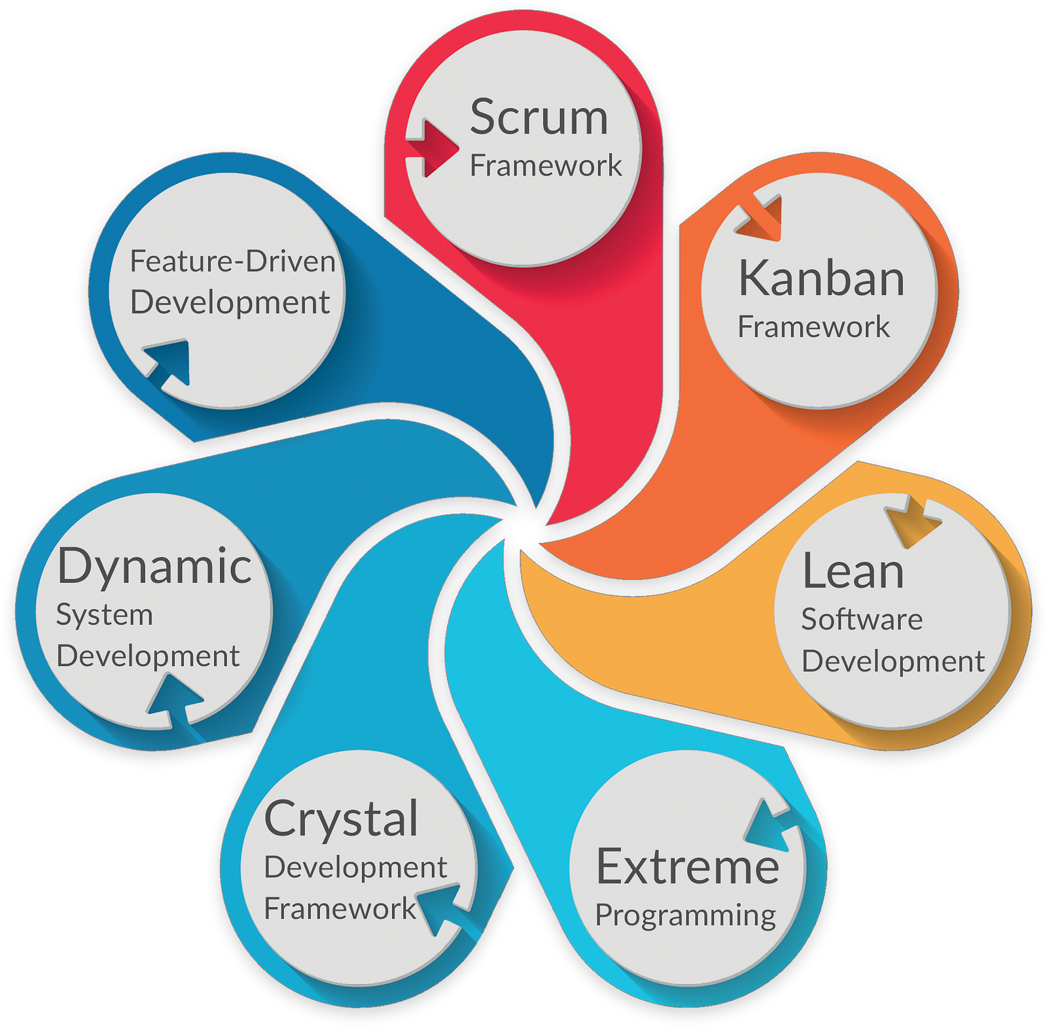
Popular Agile Frameworks & Methodologies

Slide 36
Quiz Time
How many values & principles are listed in Agile Manifesto?
What are the 4 Agile values given in Agile Manifesto?
Name any 6 Agile principles given in Agile Manifesto
One project wants to adopt Agile as it feels they can do away with documentation and focus on the working software? Is this a correct reason to adopt Agile ?
Your company is adopting Scrum. There are 10 developers and a PO. How can the teams be divided? Choose the best answer
Development team meets and decides to go for 2 cross functional teams of 4 and 6 developers
Development team meets and decides to go for 1 cross functional team of 10 developers
Development team meets and decides to go for 3 cross functional teams of 2, 4 and 4 developers
Development team meets and decides to go for 2 cross functional teams of 3 and 4 developers and 1 team of 3 testers

